Slide 1
Parsing and Casting

Slide 3

What We’ll Be Doing Today
Parsing vs. Casting
Parsing Syntax
Casting Syntax

Slide 4
Parsing vs. Casting
Both can be thought of as converting but they convert in different ways.

Slide 5
Parsing vs. Casting
Both can be thought of as converting but they convert in different ways.
Parsing and casting are powerful tools that can be used to manipulate data in Java, and in strongly typed languages are essential.

Slide 6
Parsing vs. Casting
Parsing is a general term that refers to the process of converting a string into a data structure in java.

Slide 7
Parsing vs. Casting
Parsing is a general term that refers to the process of converting a string into a data structure in java.
Can also be thought of as evaluating.

Slide 8
Parsing vs. Casting
Parsing is a general term that refers to the process of converting a string into a data structure in java.
Can also be thought of as evaluating.
Casting is a more specific type of parsing. It is the process of converting an object of one type into an object of another type.

Slide 9
Parsing vs. Casting
Parsing is a general term that refers to the process of converting a string into a data structure in java.
Can also be thought of as evaluating.
Casting is a more specific type of parsing. It is the process of converting an object of one type into an object of another type.
Will not always evaluate correctly with all conversions.

Slide 10

Parsing Syntax
Java parseInt () method is used to get the primitive data type from a specific string. In other words it converts a string to a number.

Slide 11
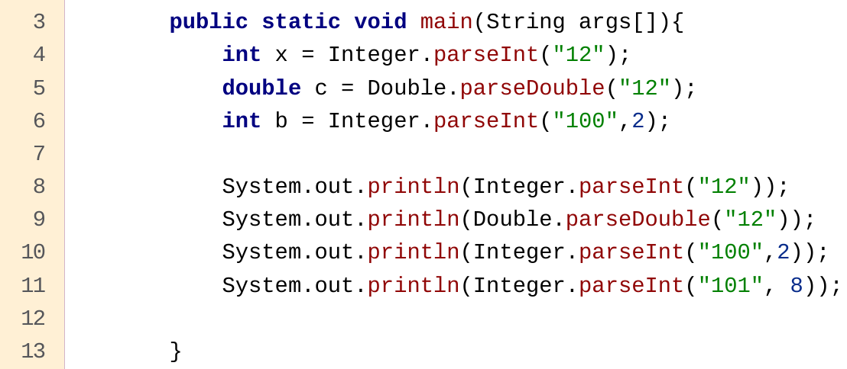
Parsing Syntax
Java parseInt () method is used to get the primitive data type from a specific string. In other words it converts a string to a number.

Slide 12
Parsing Syntax
Output: 12
12.0
4
65
Java parseInt () method is used to get the primitive data type from a specific string. In other words it converts a string to a number.

Slide 13
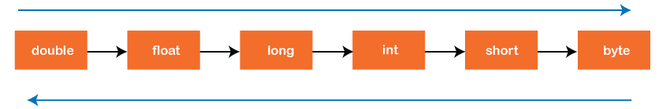
Casting Principles
Casting, as opposed to parsing, makes no effort to interpret and instead does a simple and mindless type switch.
Narrowing, or Casting Up
Widening, or Casting Down

Slide 14
Casting Principles
Casting, as opposed to parsing, makes no effort to interpret and instead does a simple and mindless type switch.
Ideally casting doesn’t affect the data in anyway and simply changes the size at which it is stored and the type it is affiliated with.
Narrowing, or Casting Up
Widening, or Casting Down

Slide 15
Casting Principles
Narrowing, or Casting Up
Widening, or Casting Down
This, however, doesn’t always work.

Slide 16
Casting Principles
Narrowing, or Casting Up
Widening, or Casting Down
This, however, doesn’t always work.
Casting Up or in the narrowing direction will tend to have data loss as you are going from larger data types to smaller ones.

Slide 17
Casting Principles
Narrowing, or Casting Up
Widening, or Casting Down
Casting Down on the other hand is actively moving smaller data types into larger ones and will never lead to loss.

Slide 18
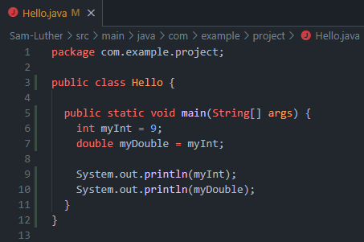
Casting Syntax
In the case of Casting Down or Widening Casting, it actually can happen automatically and with no extra syntax.

Slide 19
Casting Syntax
In the case of Casting Down or Widening Casting, it actually can happen automatically and with no extra syntax.
This is passing a smaller data type into a larger data type.

Slide 20
Casting Syntax

Slide 21
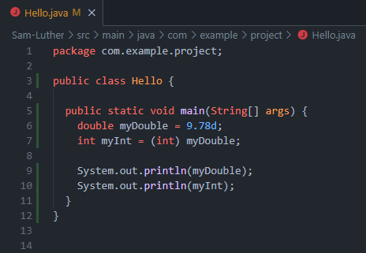
Casting Syntax
On the other hand Narrowing or Casting Up must be done manually and will throw an error without proper syntax.

Slide 22
Casting Syntax
On the other hand Narrowing or Casting Up must be done manually and will throw an error without proper syntax.
You just need to be sure you are balancing the equation while narrowing.
(data type) syntax is used to do this.

Slide 23
Casting Syntax

Slide 24

Let's hop in live share

Slide 25
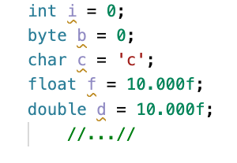
You task
Create a Java Project
> Java: Create Java Project
Add a main method
Create a variable for each primitive type:

Slide 26
Closing
Office Hours In SS-411:
Tu & Th 2pm – 3pm
Mon & Wed 10am–11am
+
Tu & Th 10pm – 12pm
Mon & Wed 3pm–5pm

Slide 27
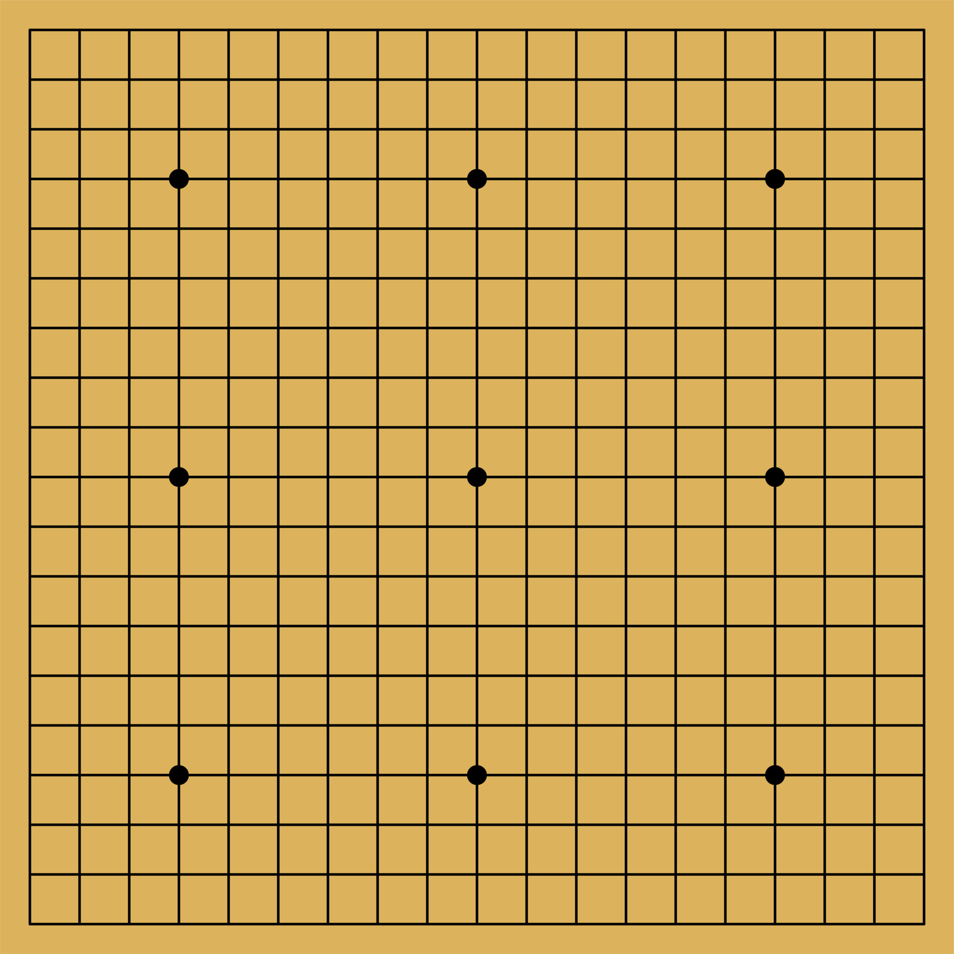
Your task
Navigate to your own project.
Create a two-dimensional array representation of a go board.
Place two go pieces, one black and one white, on the board.
Print out the board with its signature crosshatch pattern.

Slide 28
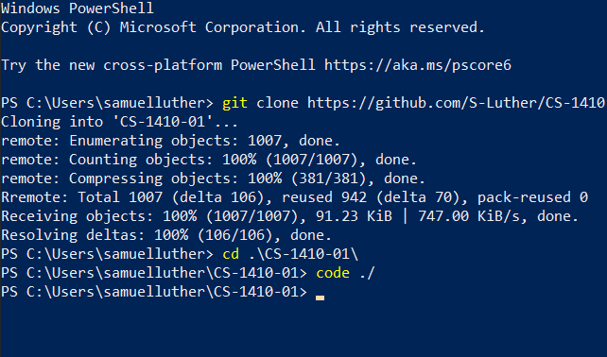
Git Commands For this Class
git clone <url>

Slide 29
Git Commands For this Class
git clone <url>
git add .

Slide 30
Git Commands For this Class
git clone <url>
git add .
git commit -m “some message”

Slide 31
Git Commands For this Class
git clone <url>
git add .
git commit -m “some message”
git push

Slide 32
Git Commands For this Class
git clone <url>
git add .
git commit -m “some message”
git push
git pull

Slide 33
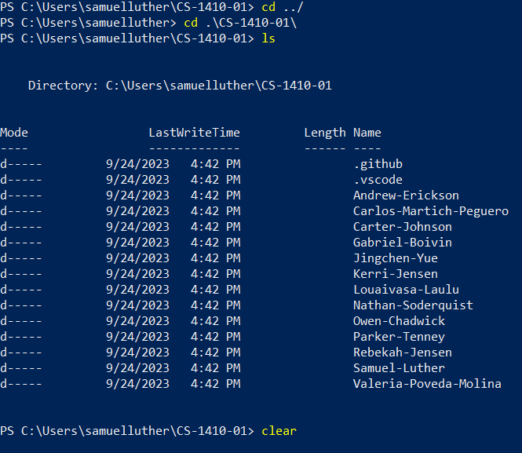
Three Other Commands
cd <some path>
Change directory (folder)
Can be autocompleted with Tab

Slide 34
Three Other Commands
cd <some path>
Change directory (folder)
Can be autocompleted with Tab
ls
List (Folders and Files)

Slide 35
Three Other Commands
cd <some path>
Change directory (folder)
Can be autocompleted with Tab
ls
List (Folders and Files)
code ./
Refers to VSCode
The ./ means open right here

Slide 36
Quick Lab and Git Example

Slide 37
Todays Lab
git clone <url>
git add .
git commit -m “”
git push
git pull
Clone down your assignment repo and make a change.
Then add your changes to the working tree, commit to a snapshot with a message, and push your changes.
Tell me that your code is up and I will make a change.
Finally you must pull and let me know if it worked.

